Slide 1


Exploring Collaborative Economy in European Tourism
Asad Ullah

Slide 2
Analyzed Airbnb's impact on European tourism, uncovering trends in guest origins, seasonal patterns, and regional dynamics. Used data visualizations and machine learning to guide sustainable tourism strategies.

Slide 3
📊 Key Highlights: ✔️ Summer peaks, winter lows. ✔️ Urban areas attract internationals; rural regions draw locals. ✔️ Predictive models for better planning. 📈 Swipe for insights! 🌟

Slide 4
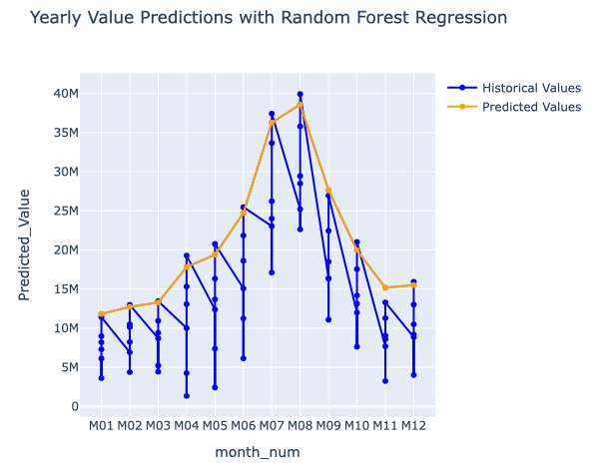
Regression

Slide 5
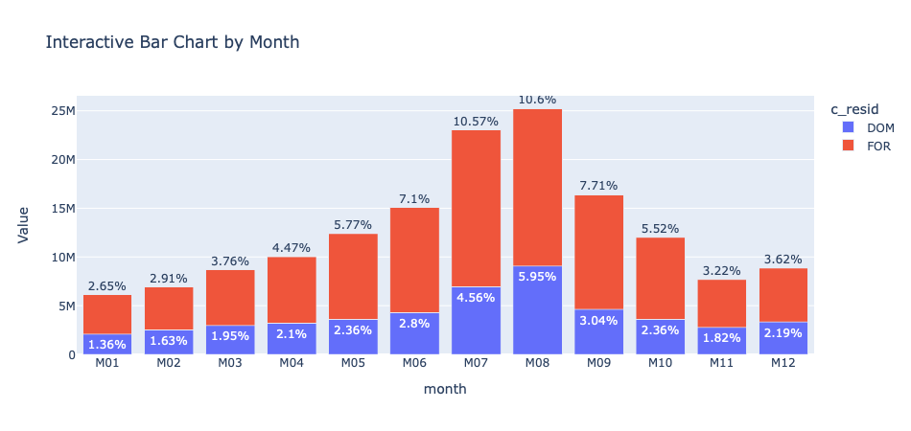

Slide 6
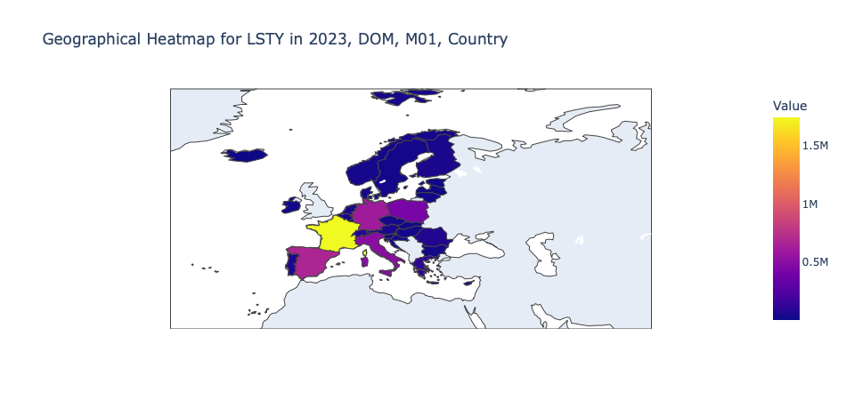

Slide 7
